Slide 1
First PS-to-SPS Transfer MD
Helga Timkó
BE-RF-BR
in collaboration with
Theodoros Argyropoulos, Thomas Bohl, Heiko Damerau, Steven Hancock, Juan Esteban Müller, Elena Shaposhnikova

Slide 2
Outline
Reminder of simulation results
Report on the MD of 29th March 2012
Aim: Optimise the PS bunch rotation timings
Measurement conditions
Results and preliminary conclusions
Why further MDs are needed

Slide 3
WHAT SIMULATIONS PREDICT
PS-TO-SPS TRANSFER:

Slide 4
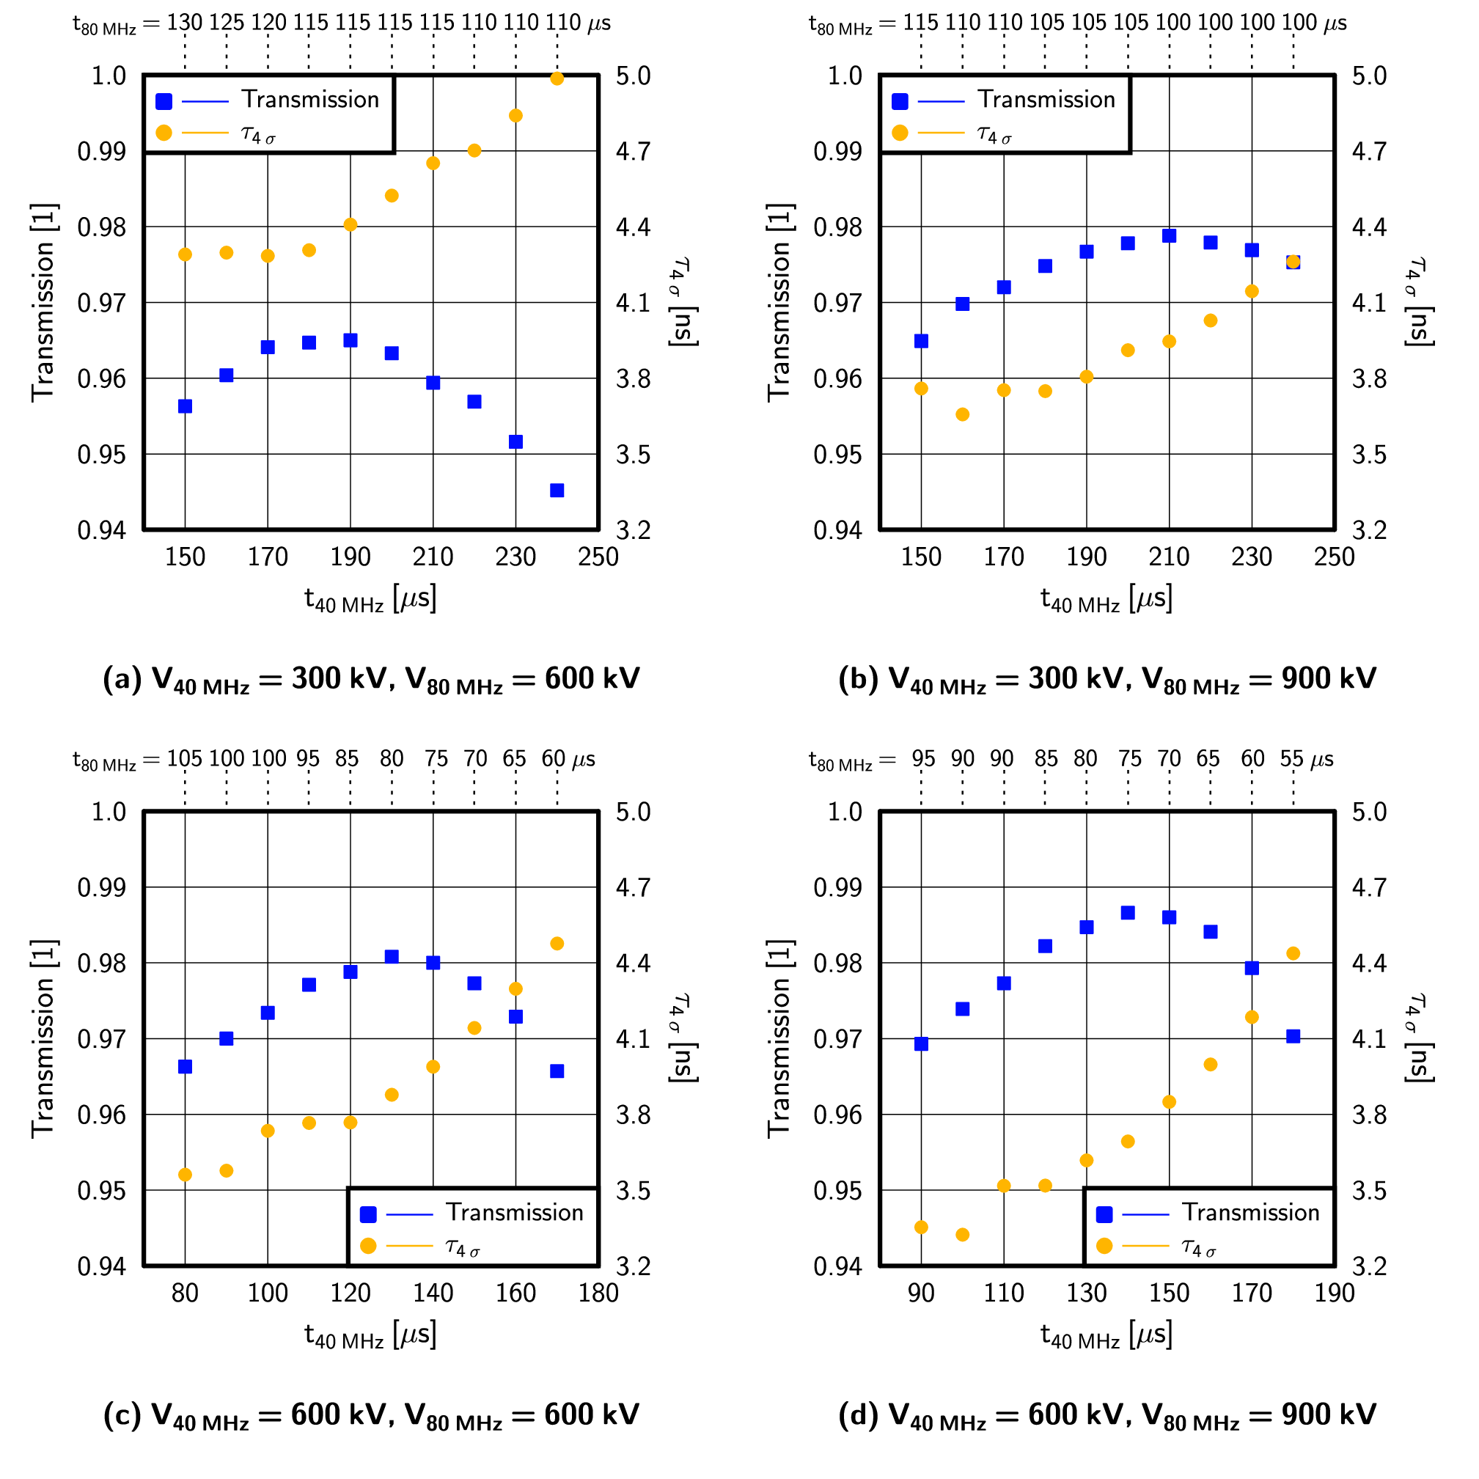
Optimising the PS bunch rotation timings
For 1+2 cavities, optimal timing reduces losses: 4.4 % → 3.5 %
Using 2+3 cavities instead of 1+2:
3.5 % → 1.3 %
Transmission can be improved even w/o more voltage

Slide 5
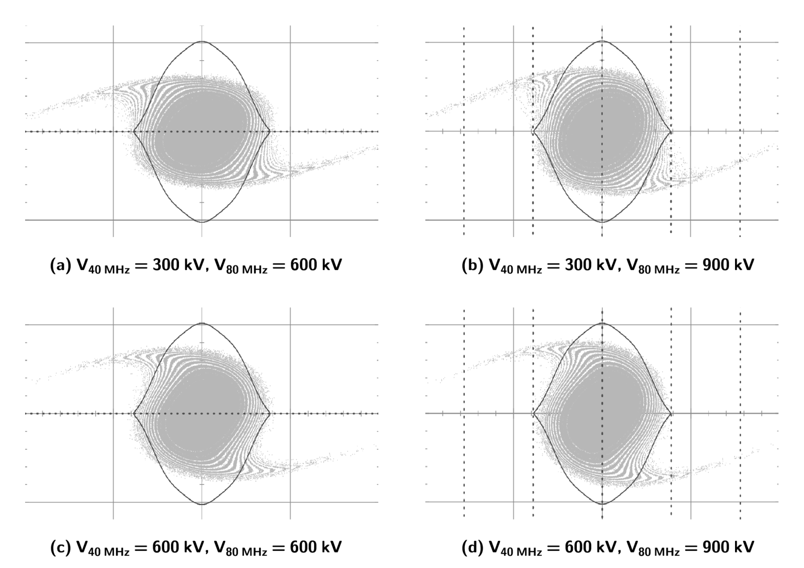
Optimised bunch shapes
… now improved:
tails less populated

Slide 6
WHAT WE MEASURE
PS-TO-SPS TRANSFER:

Slide 7
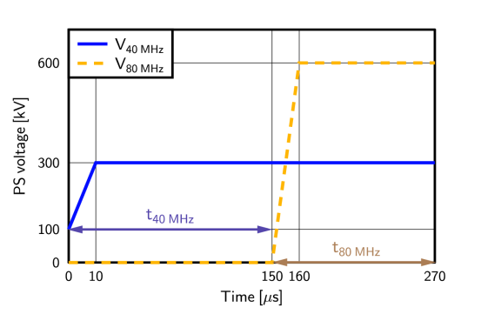
Measurement conditions
Single batch, 25 ns spaced LHC-type beam, 72 bunches
Nominal intensity, 1.1 × 10¹¹ ppb
In the PS: voltage programme as ‘usual’
Varying the rotation timings t_{40 MHz} and t_{80 MHz}
In the SPS: FB voltage was 2 MV at injection, then immediately increased to 3 MV (“usual” procedure)
V_{800 MHz} = 0.35 MV In bunch-shortening mode
Bunch length: measured at ejection from the PS with BSM
Cross-checked with bunch length measured at SPS injection
Transmission: logged from “LARGER” at the end of the FB (26 GeV) and at 62 GeV
Cross-checked with BCT data

Slide 8
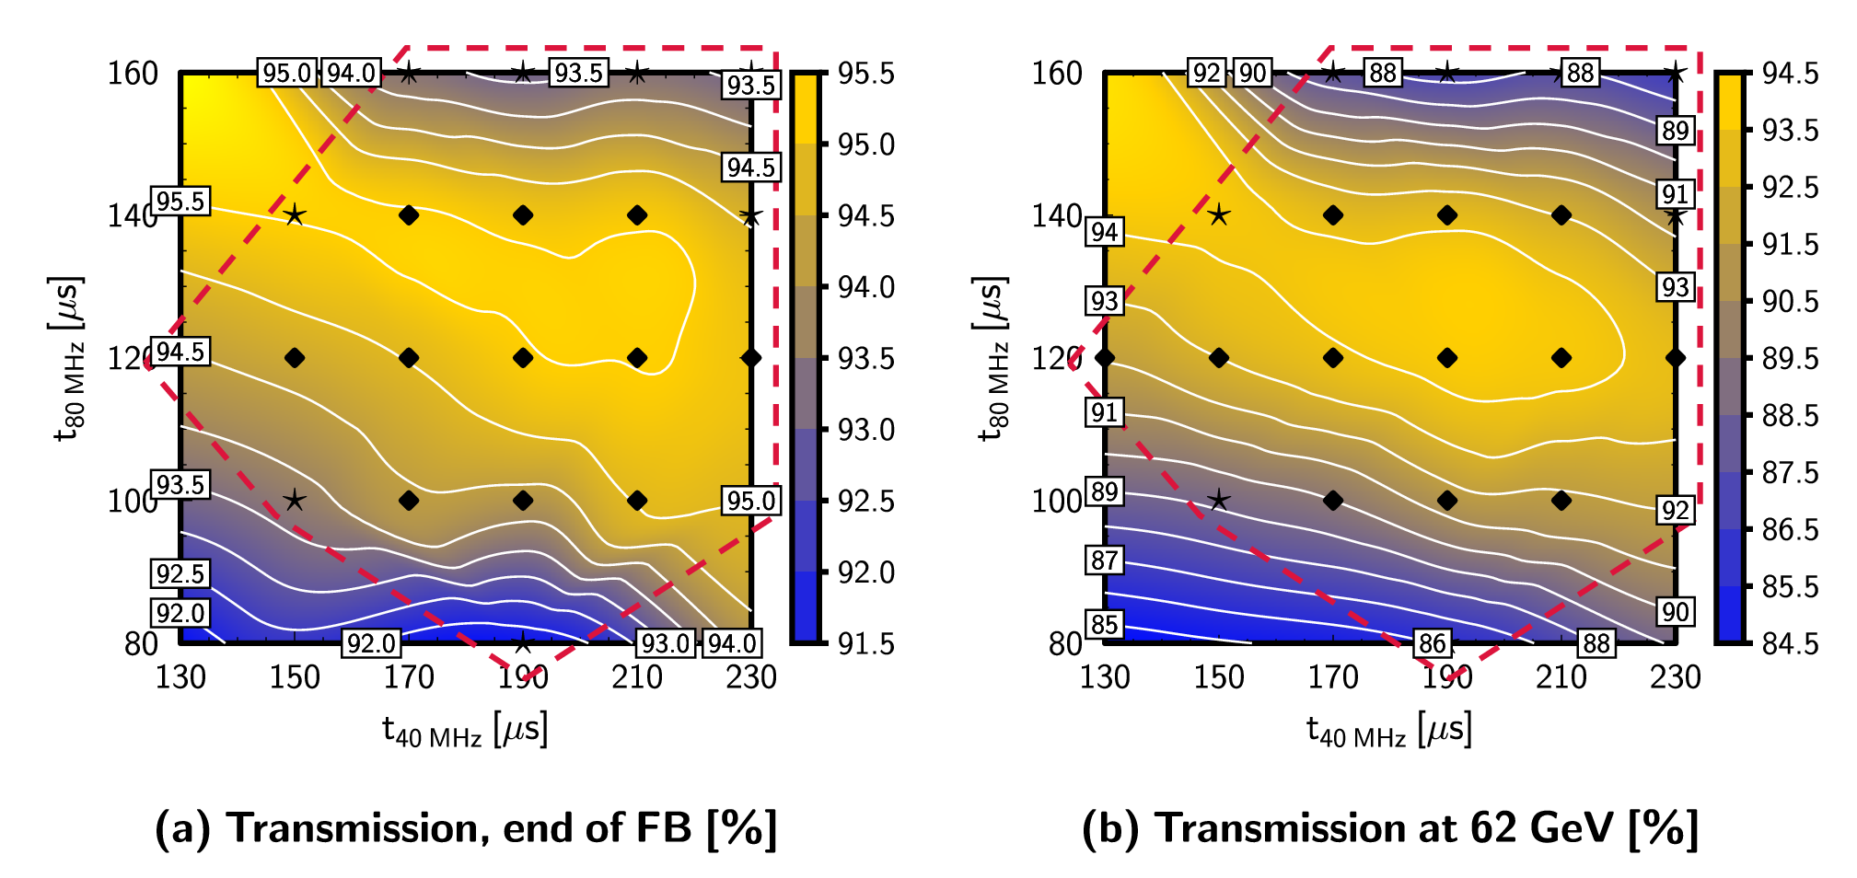
Transmission
The transmission at 62 GeV is the relevant quantity for us, since it includes losses from the acceleration ramp

Slide 9
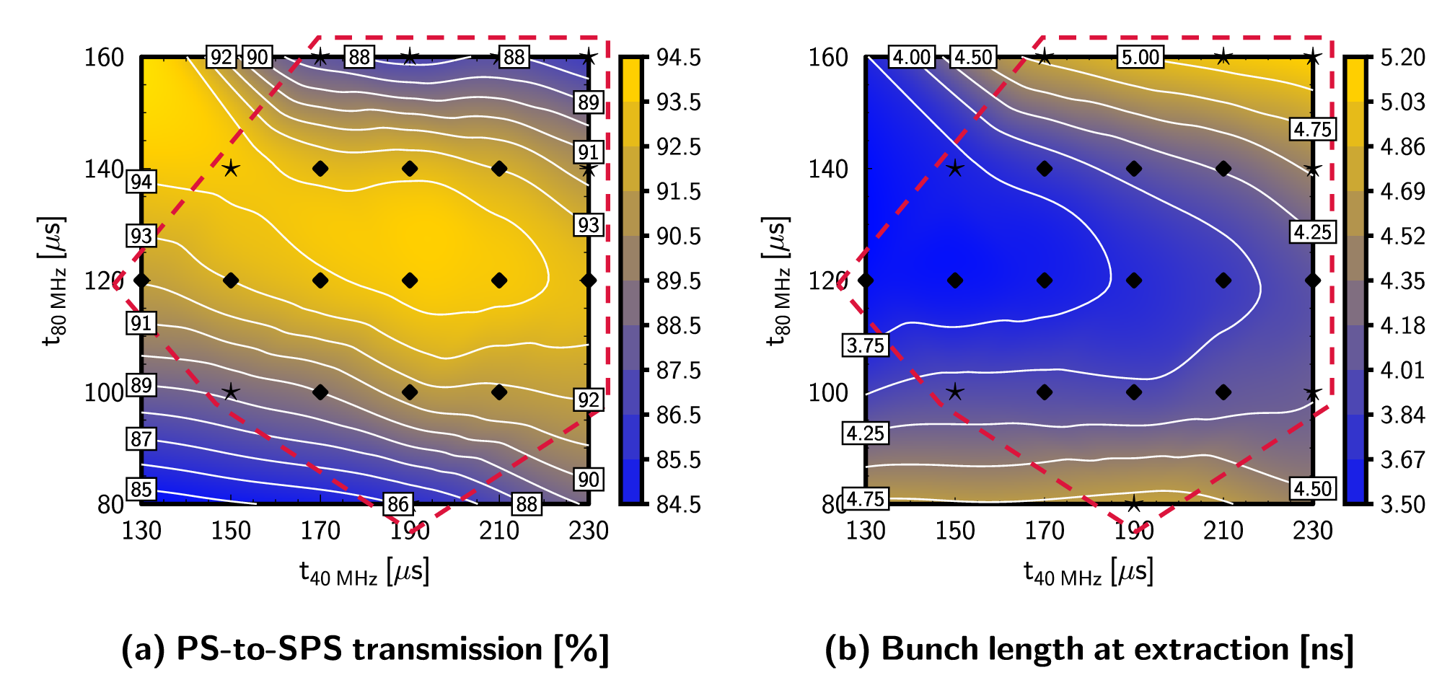
Transmission & bunch length
Better transmission can sometimes require longer bunches
Currently operational
Optimum predicted by simulations

Slide 10
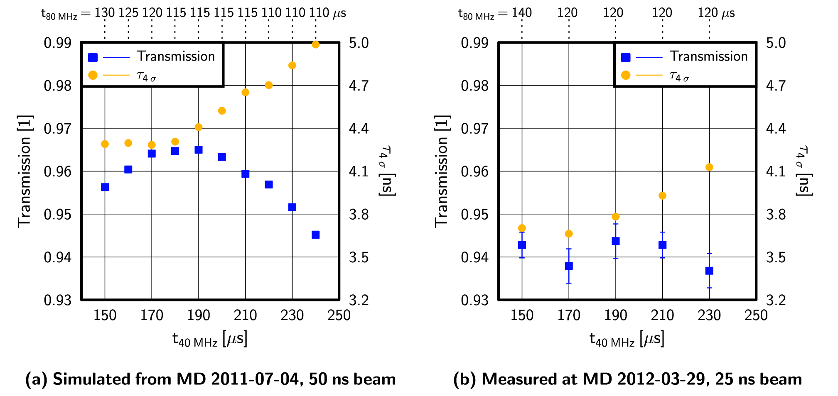
Comparison with simulations
Systematically shorter bunches in this MD than earlier
In (b), we could fit the simulated curve, but also a constant
In (b), higher transmission for t_{40 MHz} = 150 μs than expected
Measurement needs to be repeated
Unexpectedly high transmission

Slide 11
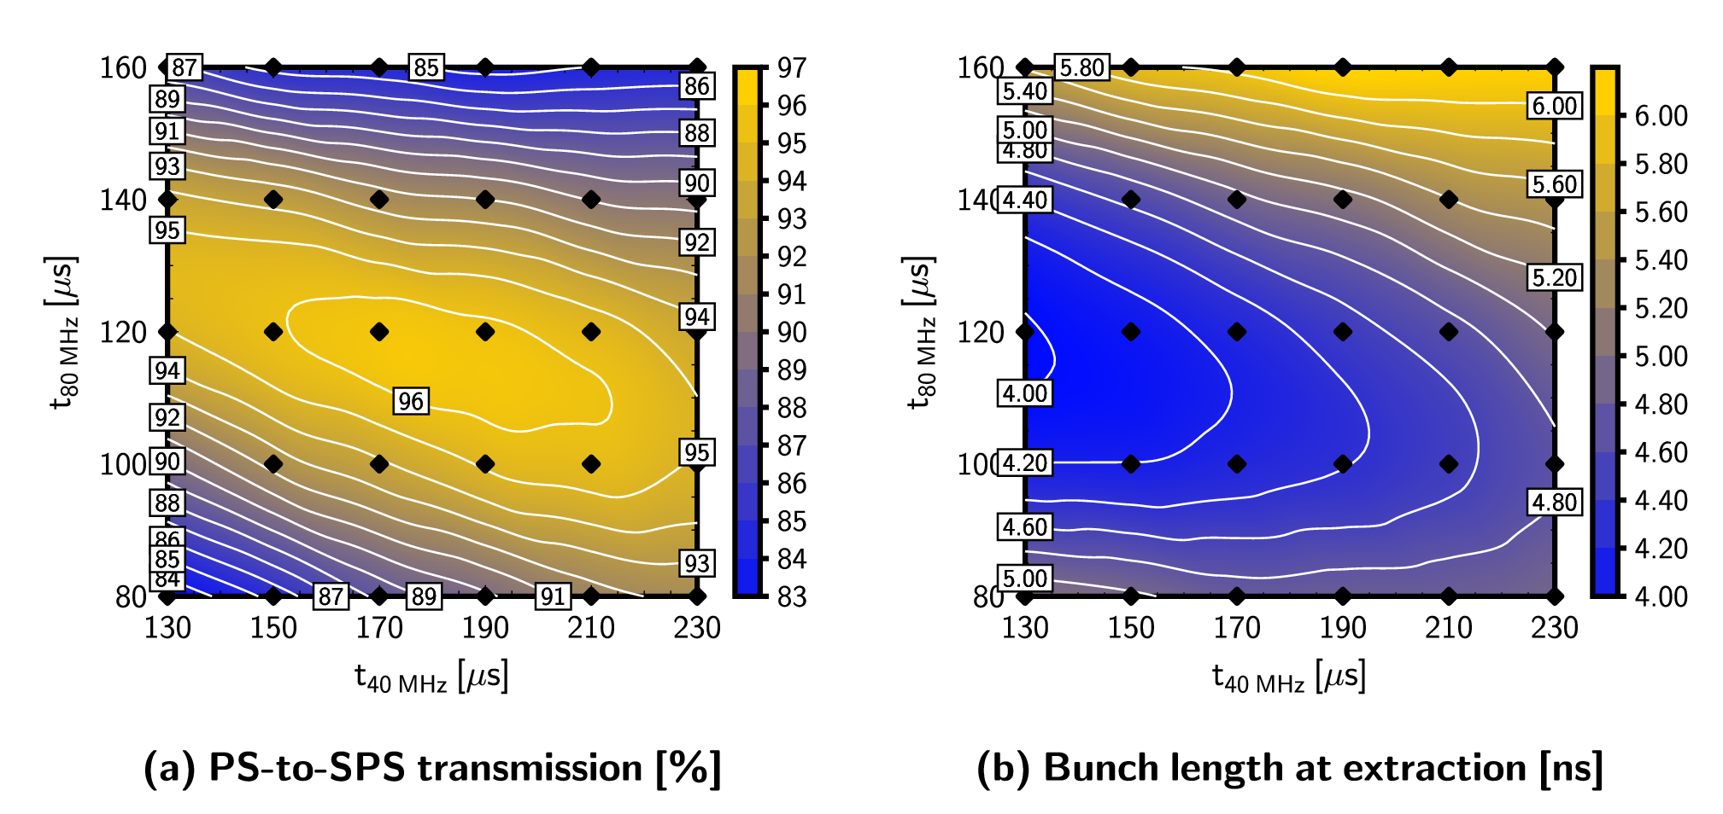
Comparison with simulations
Simulations predict a maximum ~ t_{40 MHz} = 170-190 μs, t_{80 MHz} = 120 μs
Note: longer bunches, since we took the distributions of a previous MD
Effect is small with the current intensities (order of error bars); need very accurate measurements to verify this

Slide 12
Conclusions
The first measurements are encouraging
At least, they don’t contradict the simulations
No conclusive results yet
However, measurements are ‘tricky’
We’re looking at percent-level differences
We have only percent-level accuracy
Need extremely stable beam conditions and need to ensure that the losses in the transverse plane are constant
Further measurements are planned for the future
Repeat the above & do the same scan with higher voltage

